Slide 1
RCNNs and FCNs
Credit: CS143 by James Tompkin

Slide 2
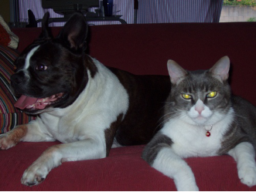
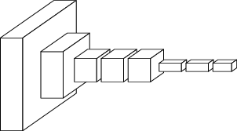
ConvNets perform classification
< 1 millisecond
“tabby cat”
1000-dim vector
end-to-end learning
[Slides from Long, Shelhamer, and Darrell]

Slide 3
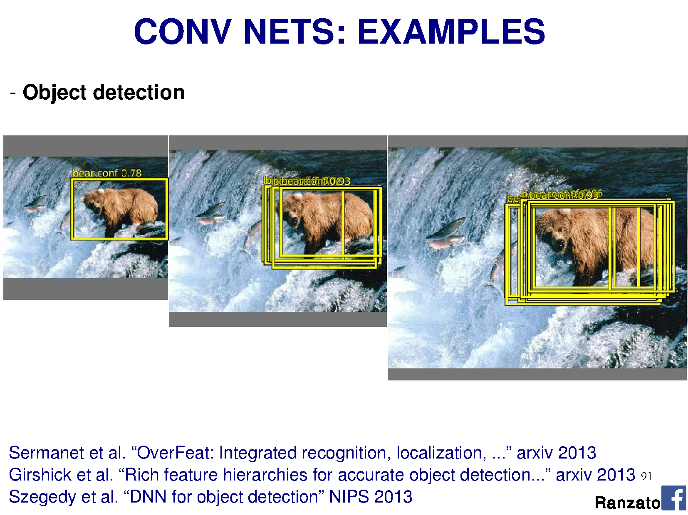

Slide 4
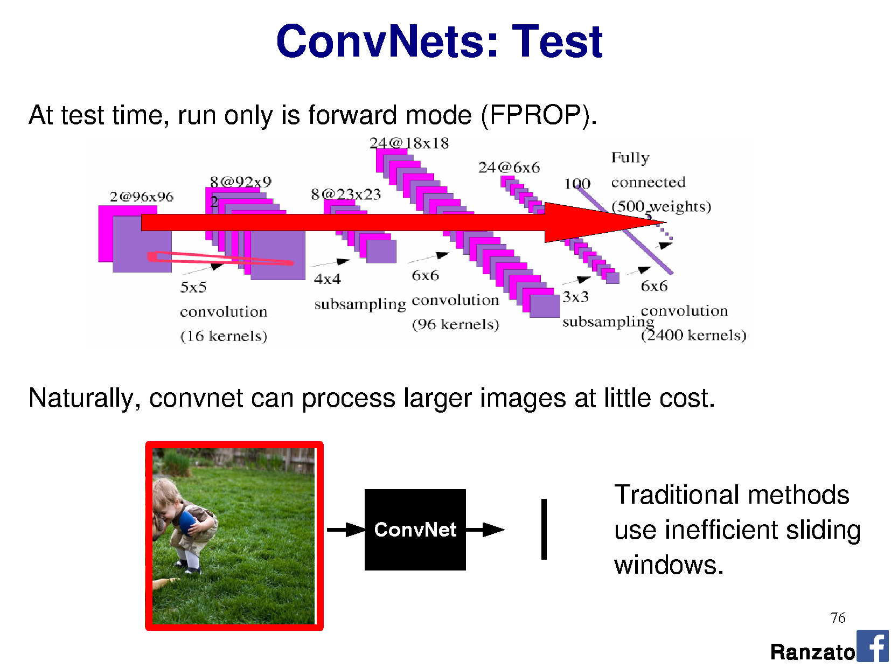

Slide 6
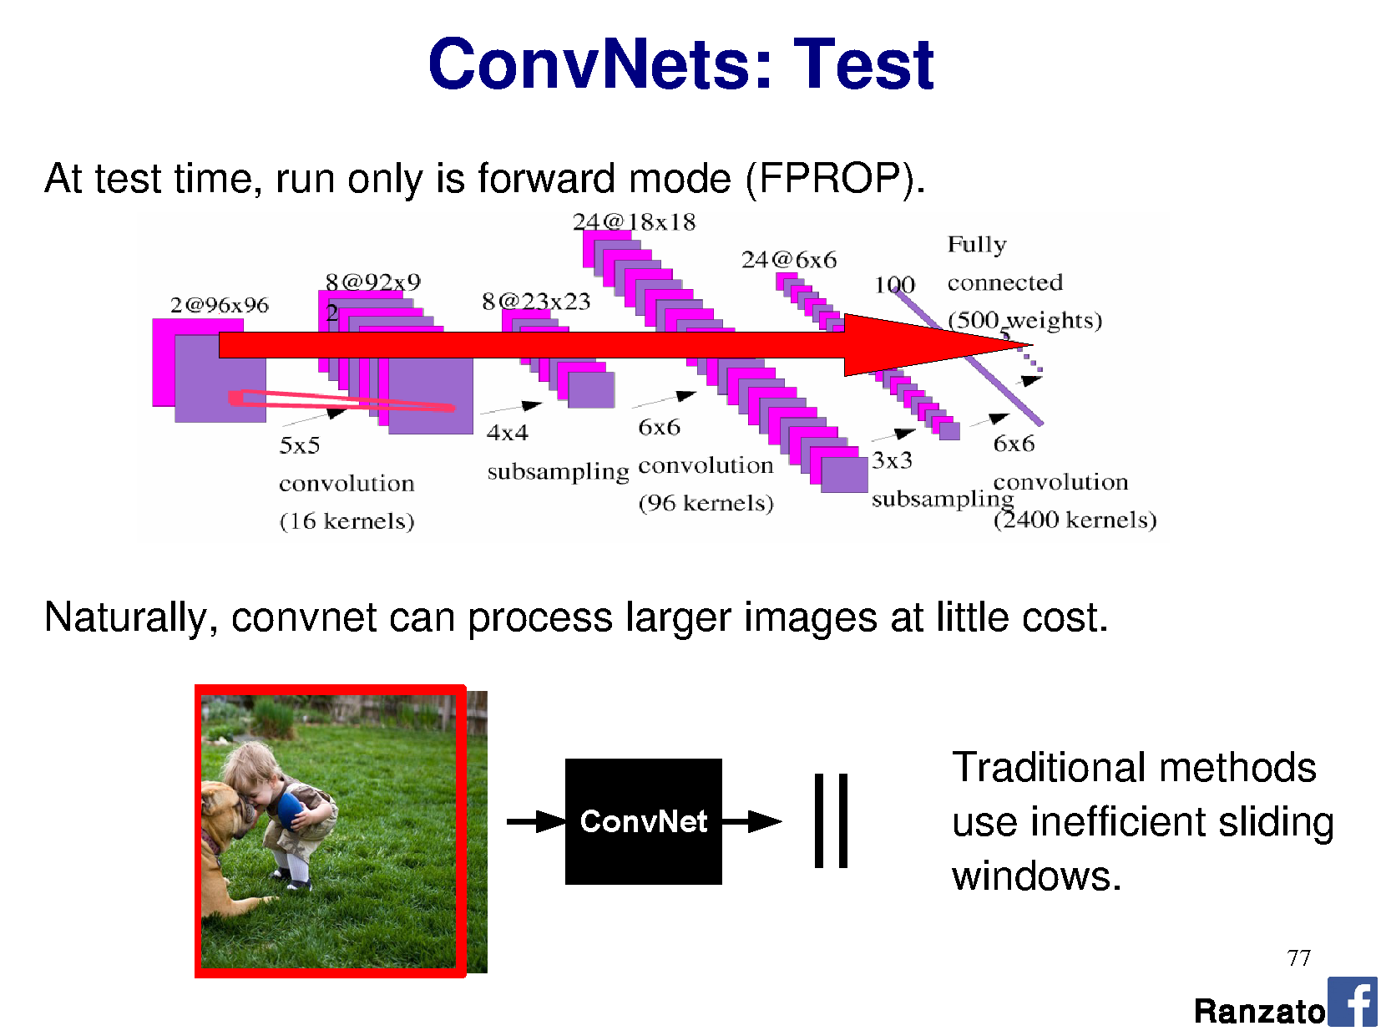

Slide 7
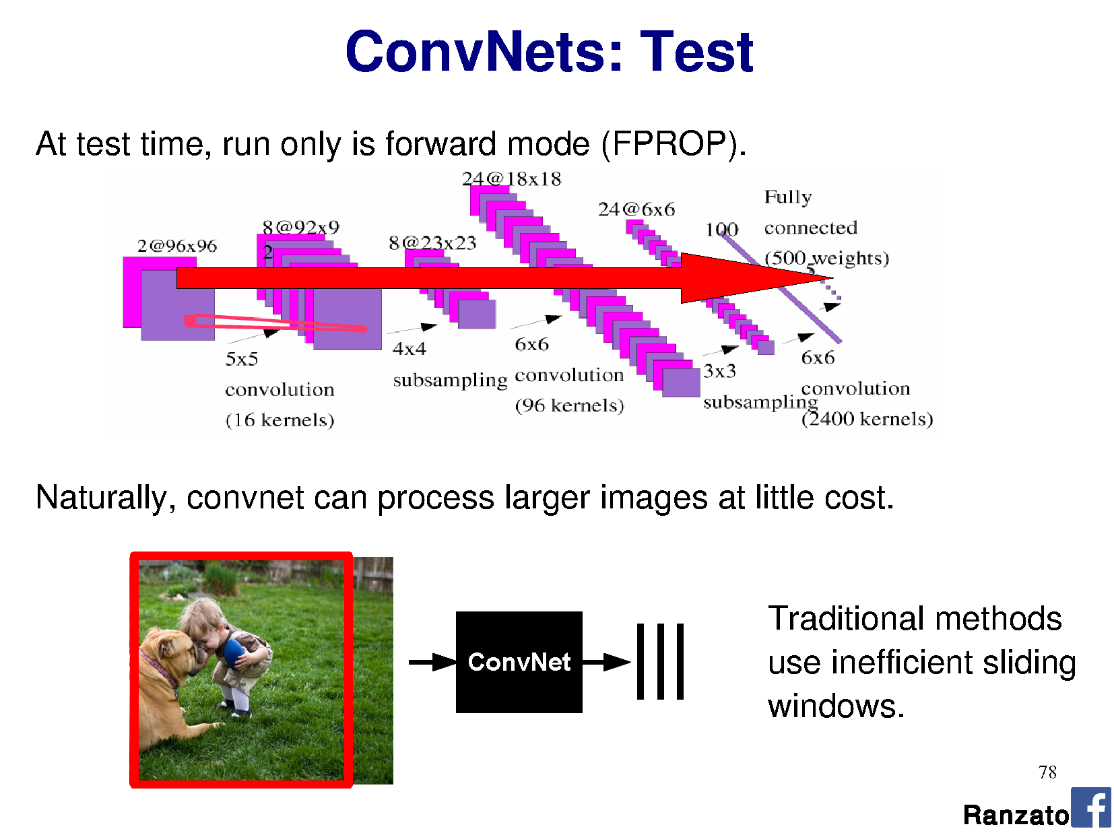

Slide 8
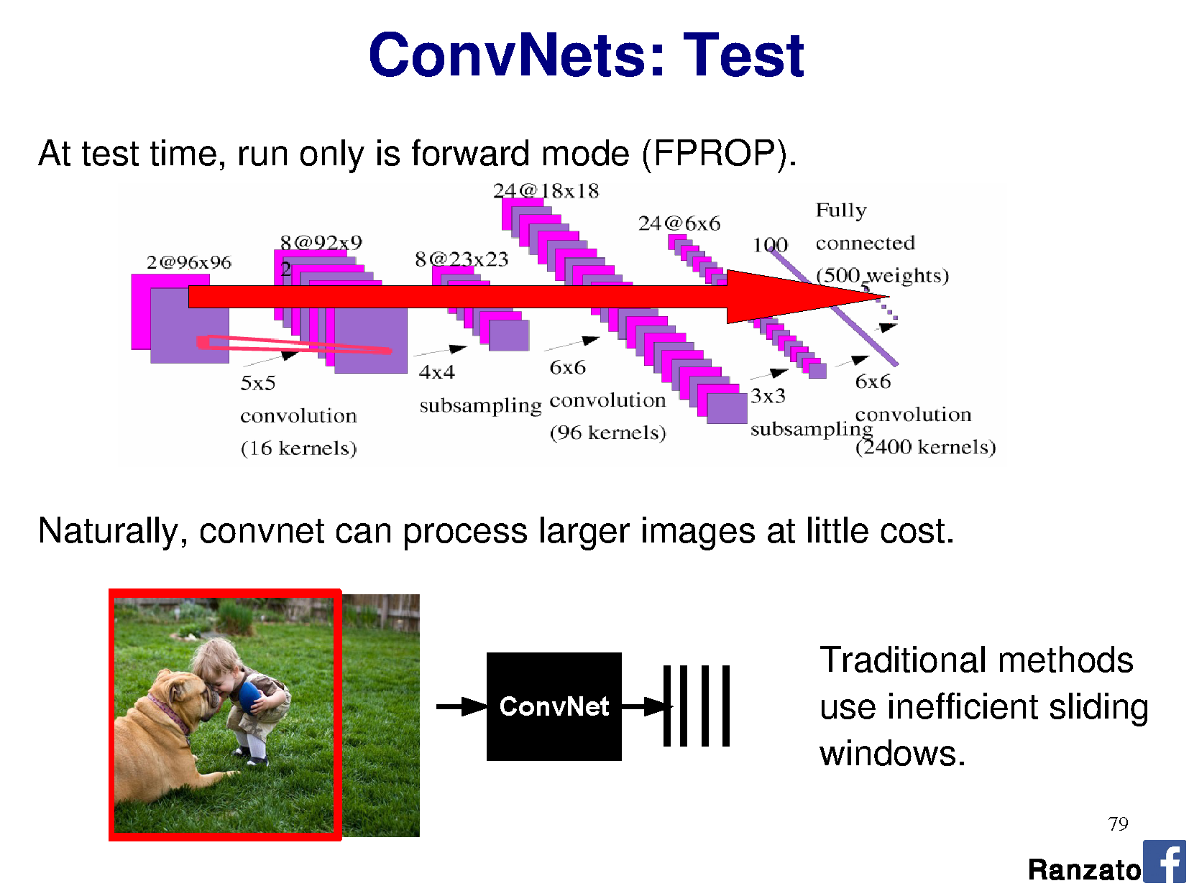

Slide 9
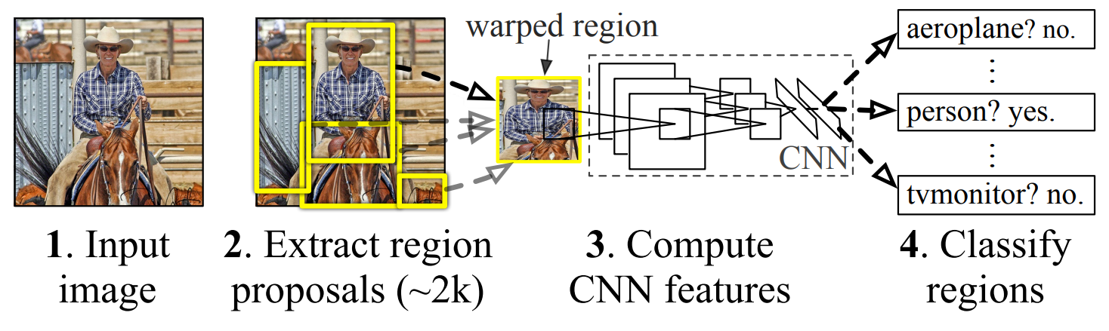
R-CNN: Region-based CNN
Figure: Girshick et al.
Notes:
https://blog.athelas.com/a-brief-history-of-cnns-in-image-segmentation-from-r-cnn-to-mask-r-cnn-34ea83205de4
http://www.cs.cornell.edu/courses/cs7670/2014sp/slides/VisionSeminar14.pdf
Where do the region proposals come from?
Step 3. Uses ‘selection search’ to find fewest bounding boxes with most recall.
Step 3. Features are pre-trained on ImageNet, then fine tuned end to end
Step 4. Classify regions = SVM on features learned from CNN.
I still have to test every region -> still slow.

Slide 10
Stage 2: Efficient region proposals?
Brute force on 1000x1000 = 250 billion rectangles
Testing the CNN over each one is too expensive
Let’s use B.C. vision! Before CNNs
Hierarchical clustering for segmentation
Uijlings et al., 2012, Selection Search
Thanks to Song Cao
Notes:
Brute force all shapes and sizes of rectangle over an image = ((m+1) choose 2 ) x ((n+1) choose 2)
B.C. vision = before CNNs

Slide 11
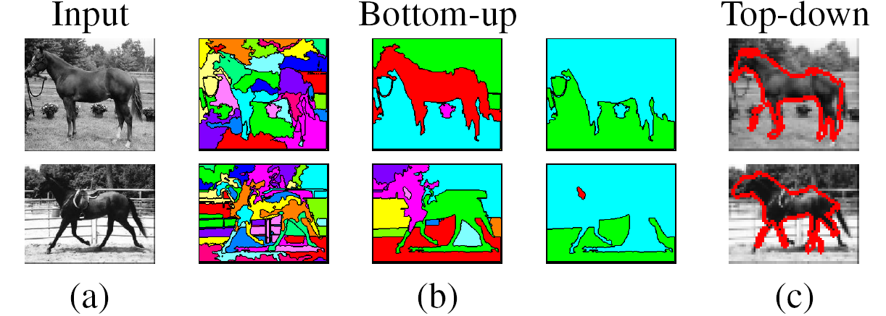
Remember clustering for segmentation?
Oversegmentation
Undersegmentation
Hierarchical Segmentations

Slide 12
Cluster low-level features
Define similarity on color, texture, size, ‘fill’
Greedily group regions together by selecting the pair with highest similarity
Until the whole image become a single region
Draw a bounding box around each one
Into a hierarchy
Notes:
http://www.cs.cornell.edu/courses/cs7670/2014sp/slides/VisionSeminar14.pdf
Fill = amount of bounding box full of the region (/ image size)

Slide 13
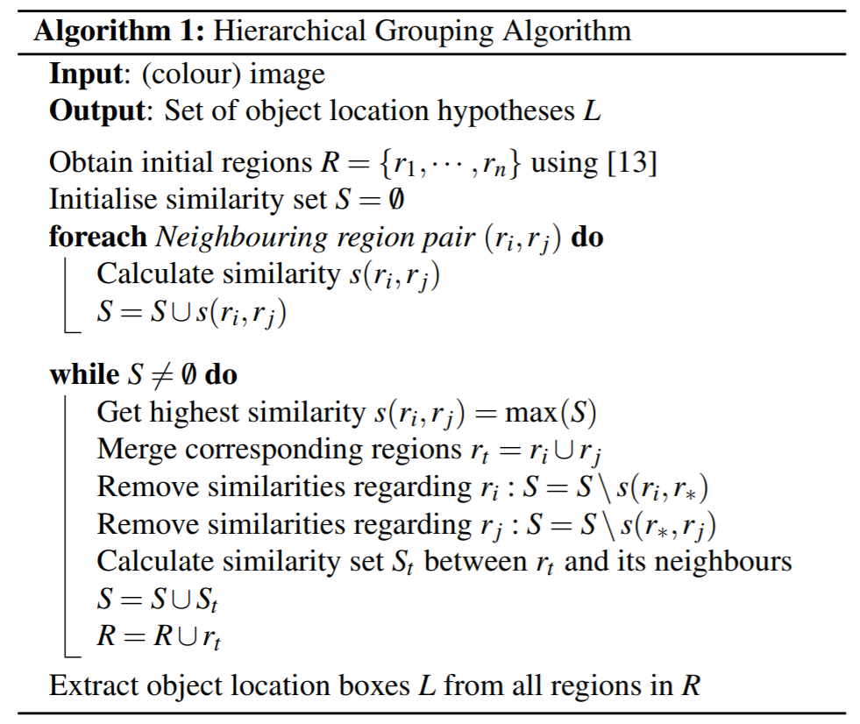
Algorithm
[13] Felzenszwalb and Huttenlocher - Efficient Graph-Based Image Segmentation, IJCV 2004

Slide 14
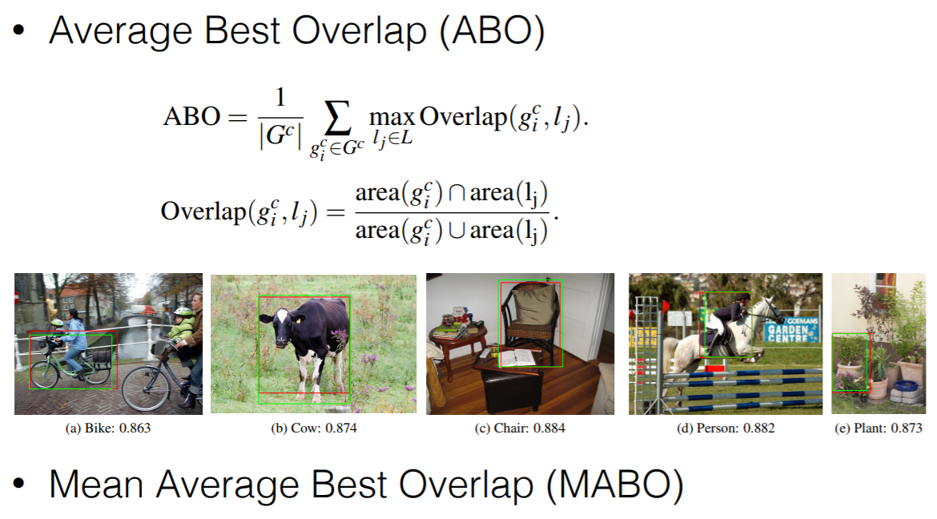
Vs Ground Truth
Thanks to Song Cao
Notes:
http://www.cs.cornell.edu/courses/cs7670/2014sp/slides/VisionSeminar14.pdf

Slide 15
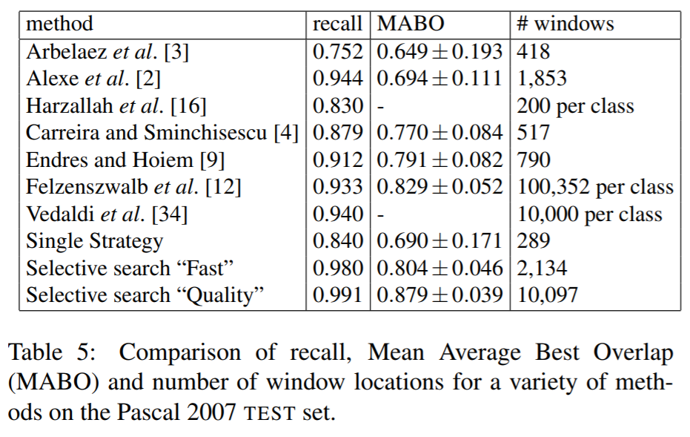
Thanks to Song Cao

Slide 16
R-CNN: Region-based CNN
Figure: Girshick et al.
10,000 proposals with recall 0.991 is better…. but still takes 17 seconds per image to generate them. Then I have to test each one!
Notes:
https://blog.athelas.com/a-brief-history-of-cnns-in-image-segmentation-from-r-cnn-to-mask-r-cnn-34ea83205de4
http://www.cs.cornell.edu/courses/cs7670/2014sp/slides/VisionSeminar14.pdf
Where do the region proposals come from?
Step 3. Uses ‘selection search’ to find fewest bounding boxes with most recall.
Step 3. Features are pre-trained on ImageNet, then fine tuned end to end
Step 4. Classify regions = SVM on features learned from CNN.
I still have to test every region -> still slow.

Slide 17
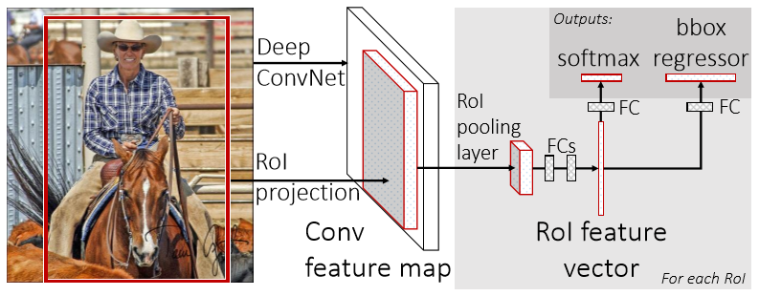
Fast R-CNN
Multi-task loss
RoI = Region of Interest
Figure: Girshick et al.
Notes:
Selection seach itself is slow – 20 seconds per image to generate regions.
Figure 1. Fast R-CNN architecture. An input image and multiple regions of interest (RoIs) are input into a fully convolutional network. Each RoI is pooled into a ﬁxed-size feature map and then mapped to a feature vector by fully connected layers (FCs). The network has two output vectors per RoI: softmax probabilities and per-class bounding-box regression offsets. The architecture is trained end-to-end with a multi-task loss.
Note: Calling your thing ‘fast’ in computing is not descriptive. In three years, it will no longer be fast, and you will look silly.

Slide 18
Fast R-CNN
Convolve whole image into feature map (many layers; abstracted)
For each candidate RoI:
Squash feature map weights into fixed-size ‘RoI pool’ – adaptive subsampling!
Divide RoI into H x W subwindows, e.g., 7 x 7, and max pool
Learn classification on RoI pool with own fully connected layers (FCs)
Output classification (softmax) + bounds (regressor)
Figure: Girshick et al.
Notes:
Figure 1. Fast R-CNN architecture. An input image and multiple regions of interest (RoIs) are input into a fully convolutional network. Each RoI is pooled into a ﬁxed-size feature map and then mapped to a feature vector by fully connected layers (FCs). The network has two output vectors per RoI: softmax probabilities and per-class bounding-box regression offsets. The architecture is trained end-to-end with a multi-task loss.

Slide 19
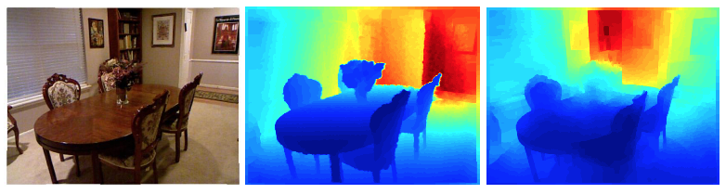

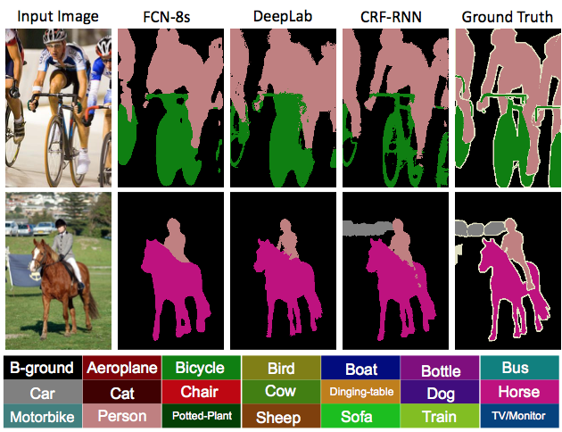
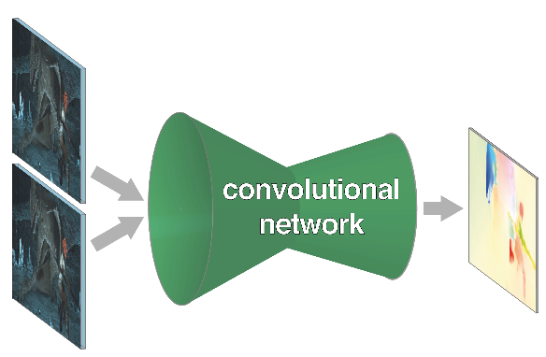
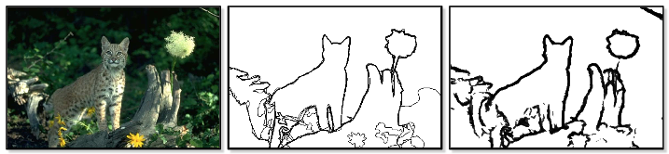
What if we want pixels out?
monocular depth estimation Eigen & Fergus 2015
semantic
segmentation
optical flow Fischer et al. 2015
boundary prediction Xie & Tu 2015
[Long et al.]
Notes:
these networks can not only do semantic segmentation, but many other pixelwise prediction tasks
these could likewise extend to video

Slide 20
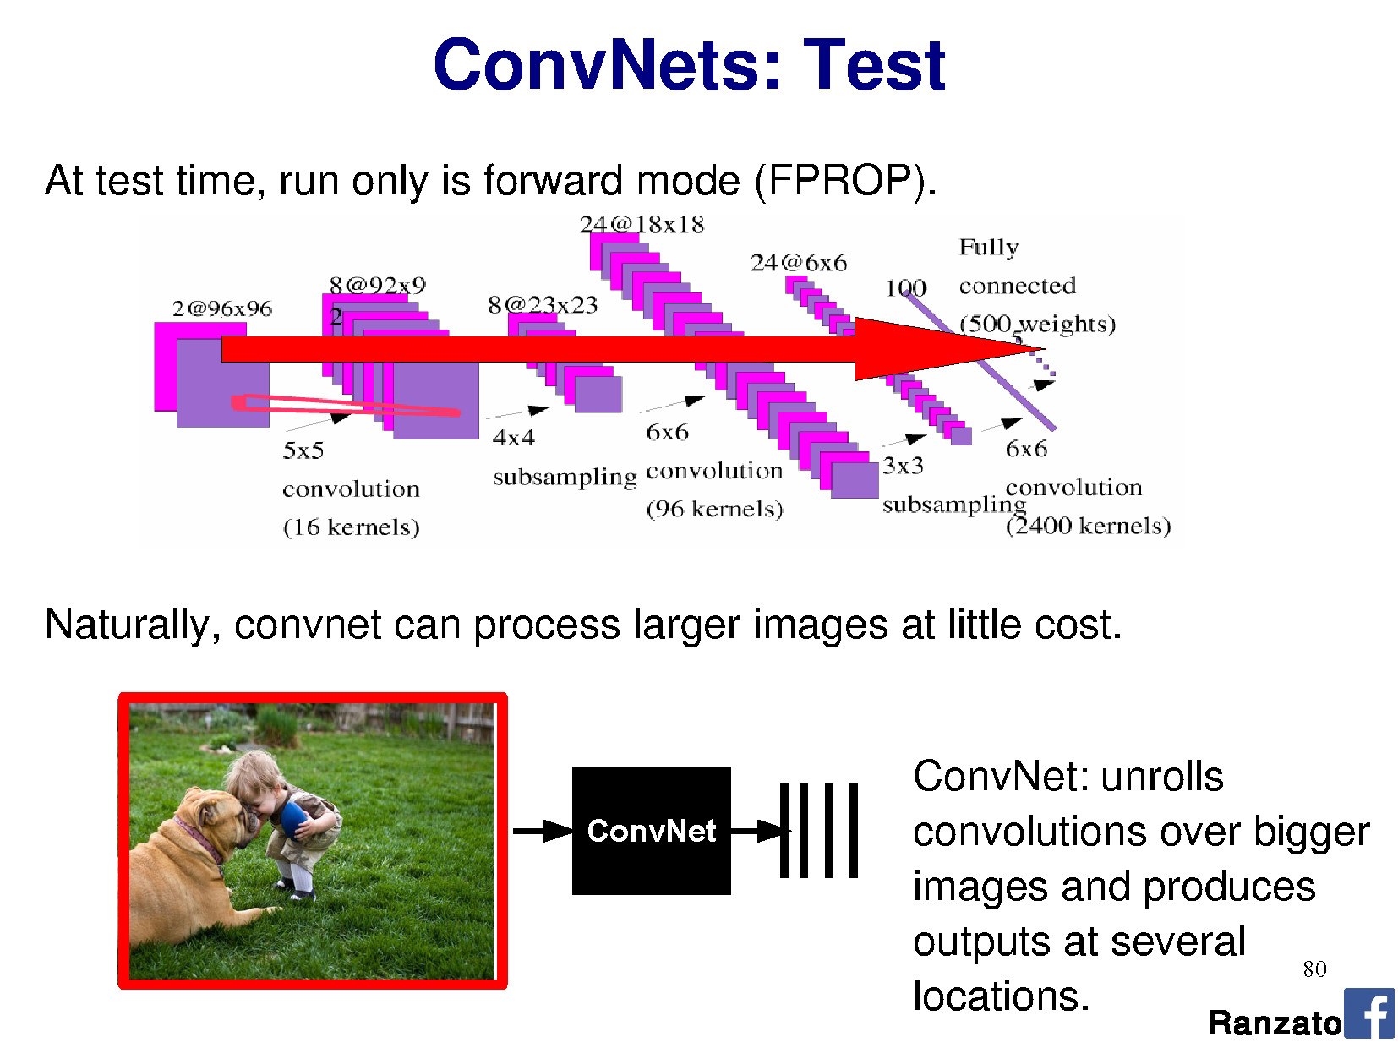

Slide 21
R-CNN does detection
many seconds
R-CNN
“dog”
“cat”
[Long et al.]

Slide 22
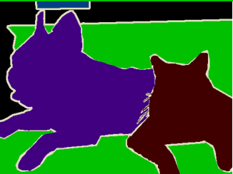
~1/10 second
???
end-to-end learning
[Long et al.]

Slide 23
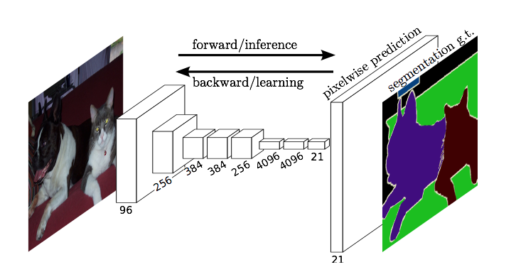
Fully Convolutional Networks for Semantic Segmentation
Jonathan Long* Evan Shelhamer* Trevor Darrell
UC Berkeley
[CVPR 2015] Slides from Long, Shelhamer, and Darrell

Slide 24
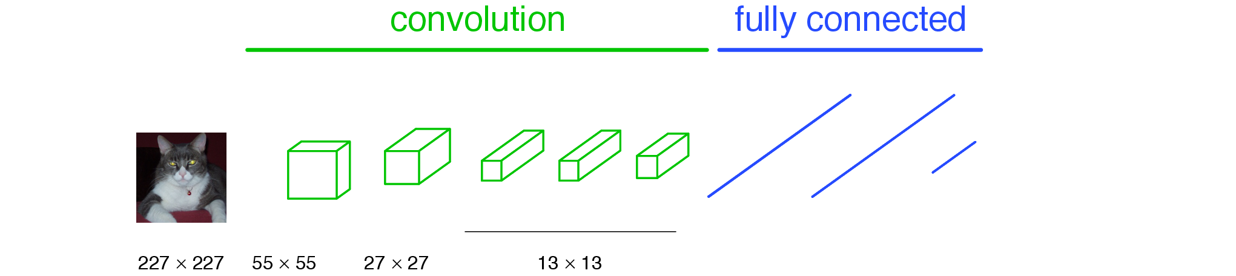
A classification network…
Number of perceptrons in MLP layer, e.g., 1024
Number of filters, e.g., 64
“tabby cat”
[Long et al.]
Notes:
note omissions
“activations”
fixed size input, single label output
desire: efficient per-pixel output

Slide 25

A classification network…
“tabby cat”
[Long et al.]
Notes:
note omissions
“activations”
fixed size input, single label output
desire: efficient per-pixel output

Slide 26
A classification network…
…
“tabby cat”
The response of every kernel across all positions are attached densely to the array of perceptrons in the fully-connected layer.
[Long et al.]
Notes:
note omissions
“activations”
fixed size input, single label output
desire: efficient per-pixel output

Slide 27
A classification network…
…
“tabby cat”
The response of every kernel across all positions are attached densely to the array of perceptrons in the fully-connected layer.
AlexNet: 256 filters over 6x6 response map
Each 2,359,296 response is attached to one of 4096 perceptrons, leading to 37 mil params.
[Long et al.]
Notes:
note omissions
“activations”
fixed size input, single label output
desire: efficient per-pixel output

Slide 28
Problem
We want a label at every pixel
Current network gives us a label for the whole image.
Approach:
Make CNN for every sub-image size ?
‘Convolutionalize’ all layers of network, so that we can treat it as one (complex) filter and slide around our full image.

Slide 29
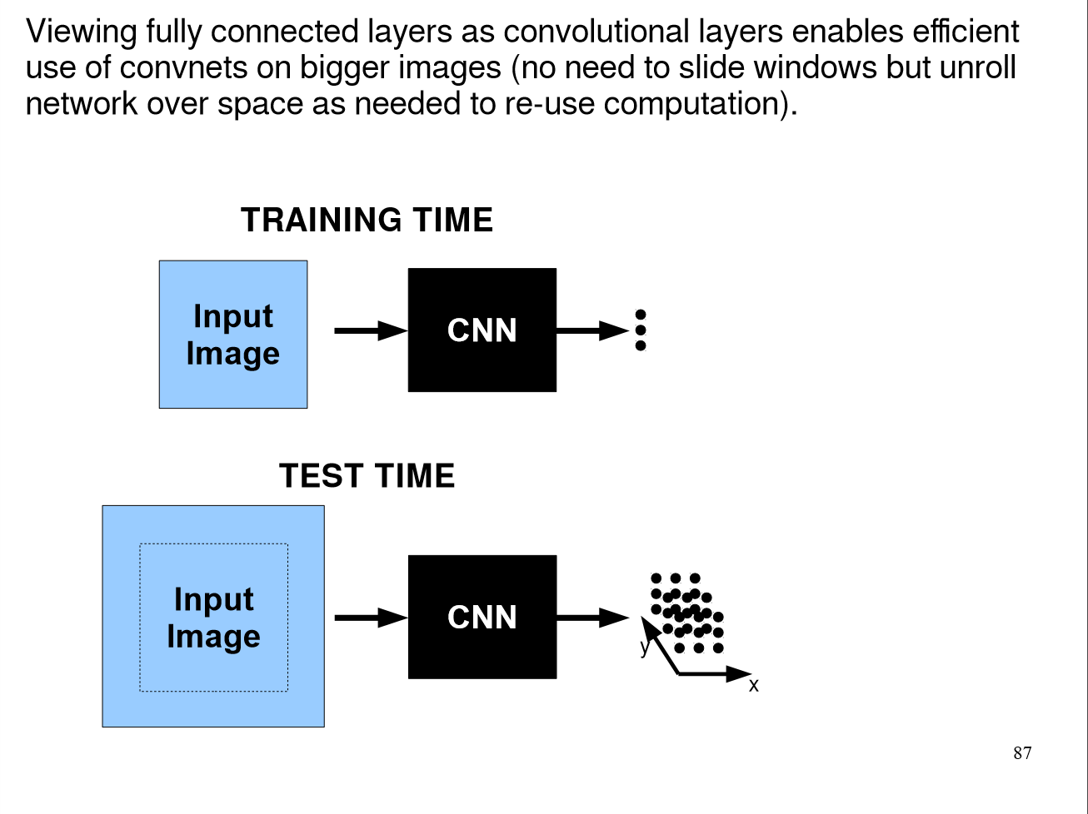

Slide 30
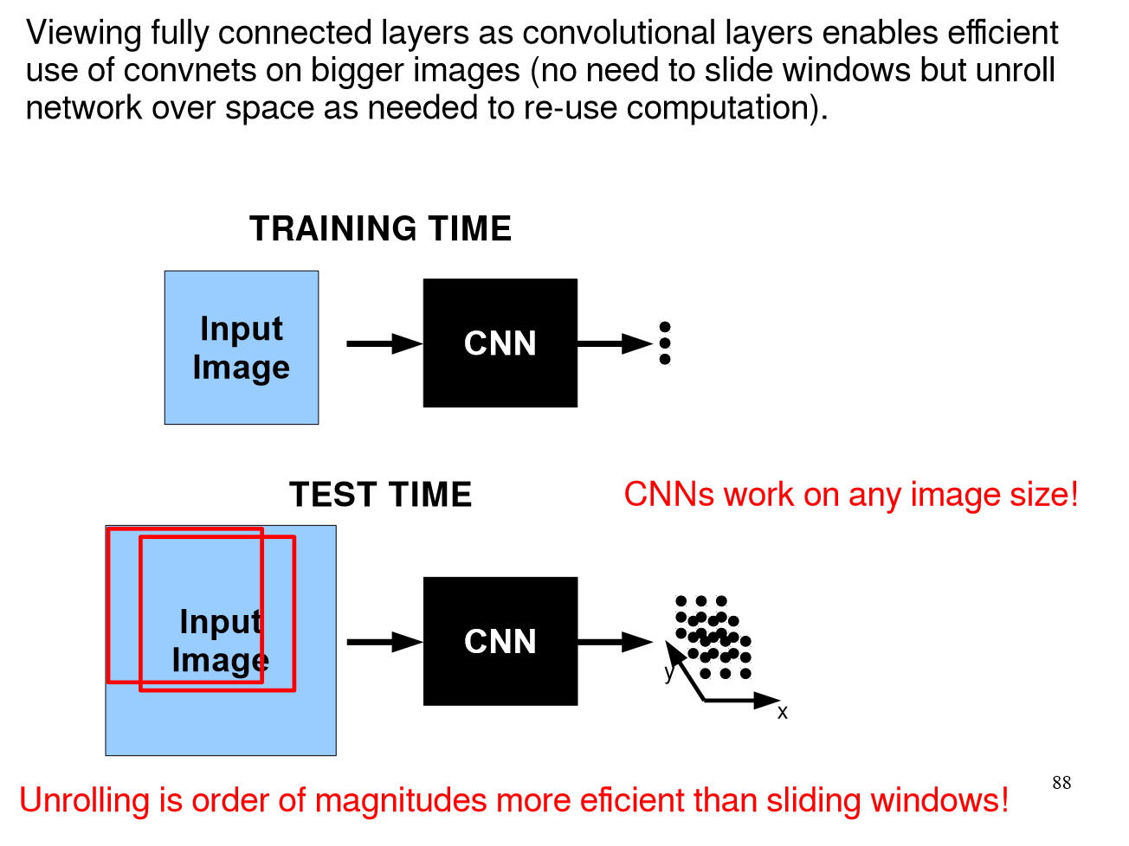

Slide 31
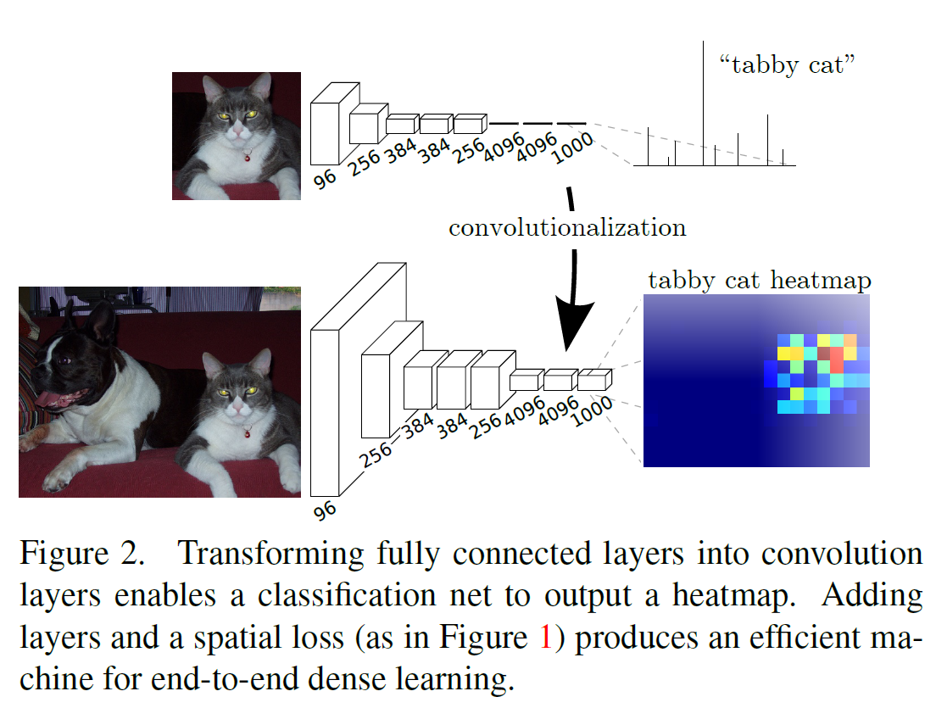
Long, Shelhamer, and Darrell 2014

Slide 32
A classification network…
…
“tabby cat”
The response of every kernel across all positions are attached densely to the array of perceptrons in the fully-connected layer.
AlexNet: 256 filters over 6x6 response map
Each 2,359,296 response is attached to one of 4096 perceptrons, leading to 37 mil params.
[Long et al.]
Notes:
note omissions
“activations”
fixed size input, single label output
desire: efficient per-pixel output

Slide 33
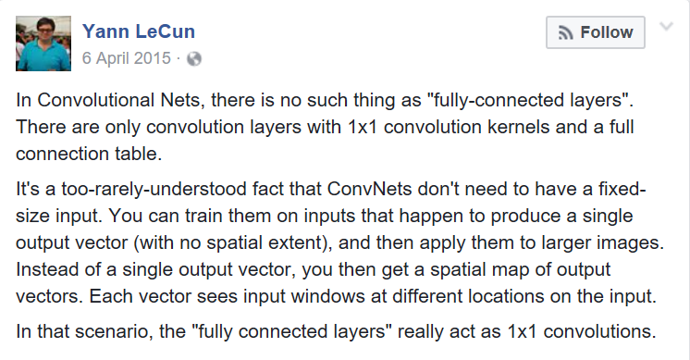

Slide 34
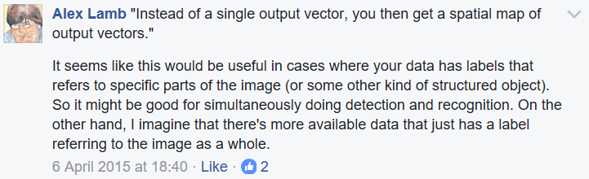
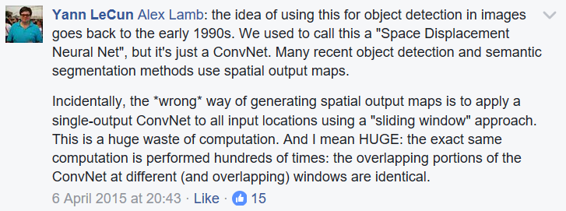

Slide 35
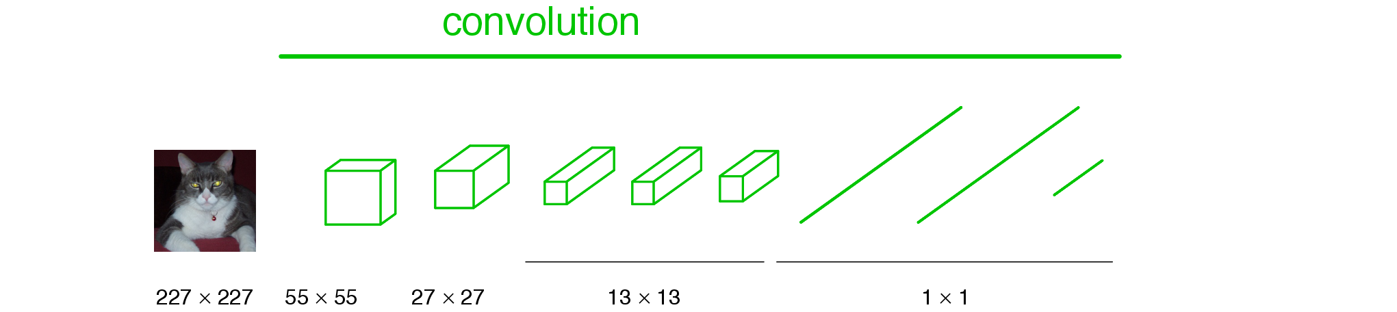
Convolutionalization
Number of filters
Number of filters
1x1 convolution operates across all filters in the previous layer, and is slid across all positions.
[Long et al.]

Slide 36
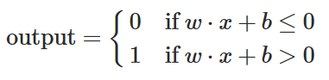
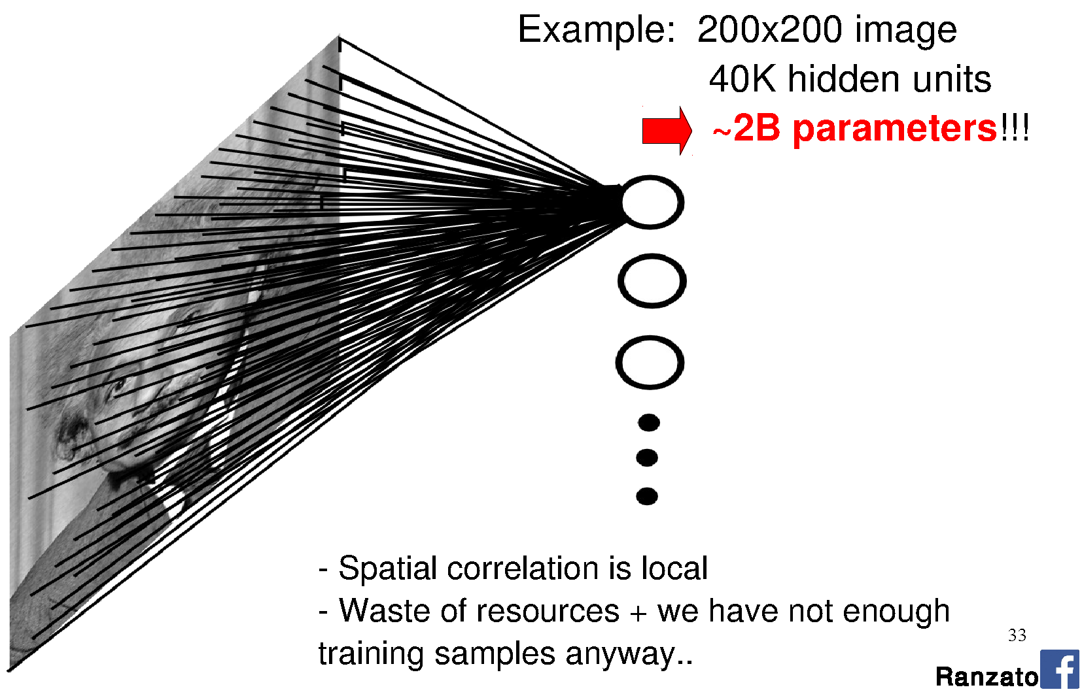
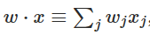
Back to the fully-connected perceptron…
Perceptron is connected to every
value in the previous layer (across all channels; 1 visible).
[Long et al.]
Notes:
Seems fine, right?
Going to learn a neural network to classify an image. Learn weights from a large database of images using back propagation.
How many perceptrons do you think we need to represent the ‘complexity’ of natural images?
How big are the weight matrices?
How many weight parameters did you learn in your HOG-based SVM classification? How big was the database? Did it work?
The more parameters we have, the larger the database we need to ‘map out’ the high-dimensional space.
Are we wasting any knowledge in this representation?

Slide 37
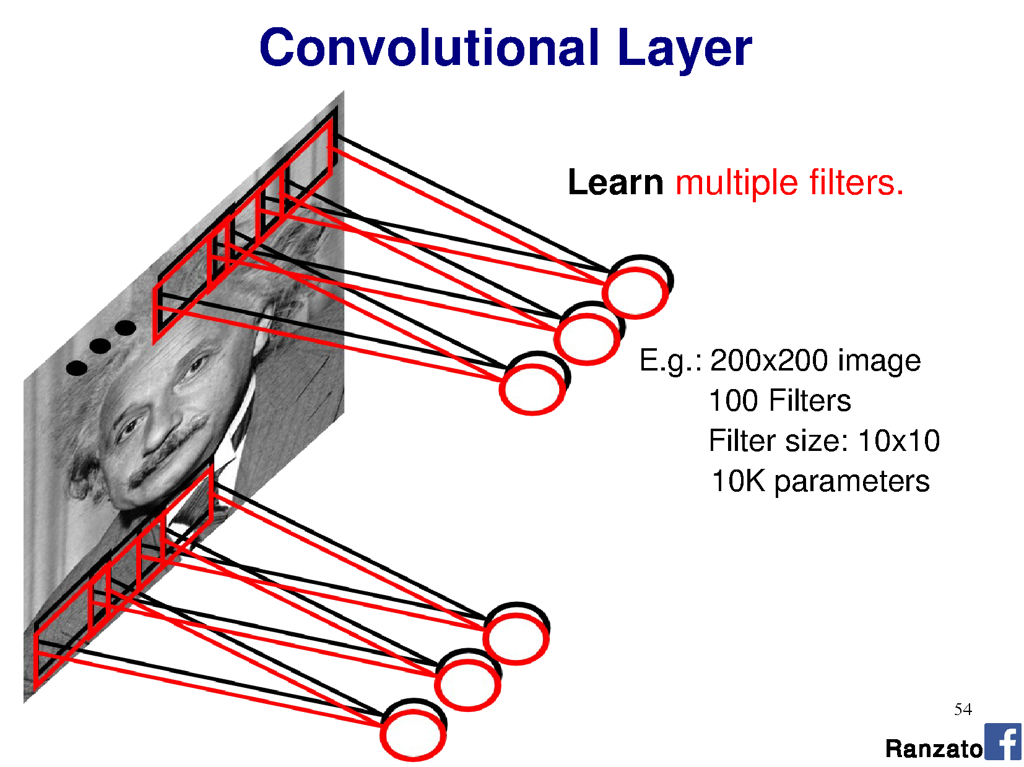
Notes:
This is the major trick.
For each layer of the neural network, we’re going to learn multiple filters.

Slide 38
1x1
100
Notes:
This is the major trick.
For each layer of the neural network, we’re going to learn multiple filters.

Slide 39
Convolutionalization
# filters, e.g. 1024
# filters, e.g., 64
1x1 convolution operates across all filters in the previous layer, and is slid across all positions.
e.g., 64x1x1 kernel, with shared weights over 13x13 output, x1024 filters = 11mil params.
[Long et al.]

Slide 40
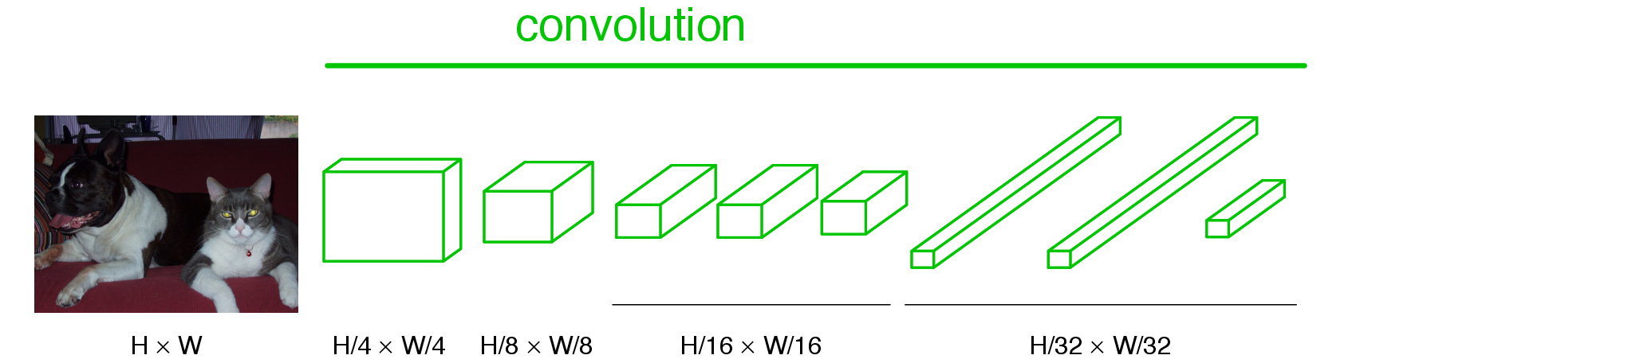
Becoming fully convolutional
Multiple outputs
Arbitrary-sized image
When we turn these operations into a convolution, the 13x13 just becomes another parameter and our output size adjust dynamically.
Now we have a vector/matrix output, and our network acts itself like a complex filter.
[Long et al.]

Slide 41
Long, Shelhamer, and Darrell 2014

Slide 42
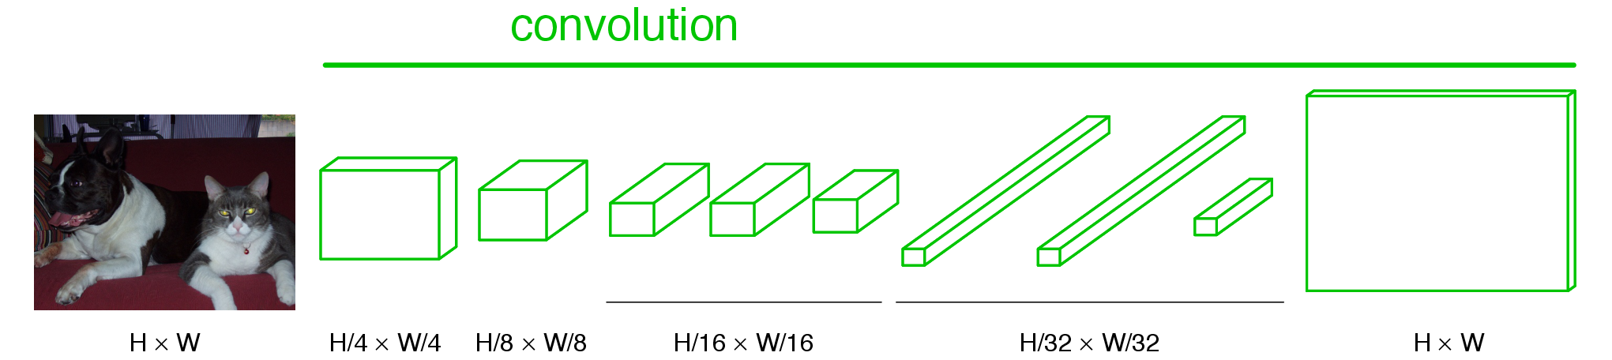
Upsampling the output
Some upsampling algorithm to return us to H x W
[Long et al.]

Slide 43
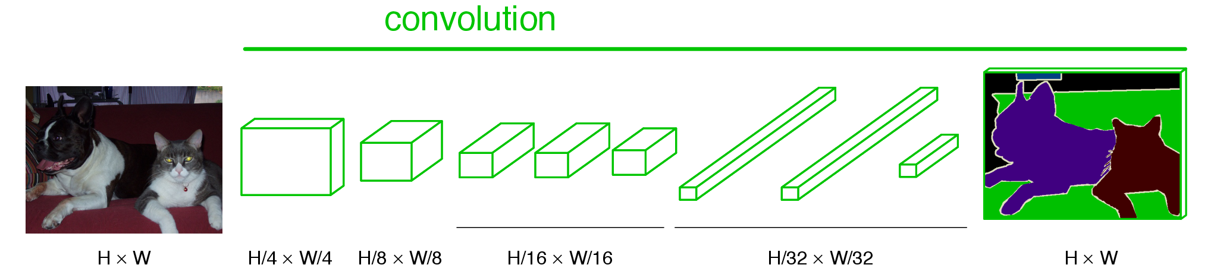
End-to-end, pixels-to-pixels network
[Long et al.]

Slide 44
End-to-end, pixels-to-pixels network
upsampling
conv, pool,
nonlinearity
pixelwise output + loss
[Long et al.]

Slide 45
What is the upsampling layer?
This one.
Hint: it’s actually an upsampling network
[Long et al.]

Slide 46
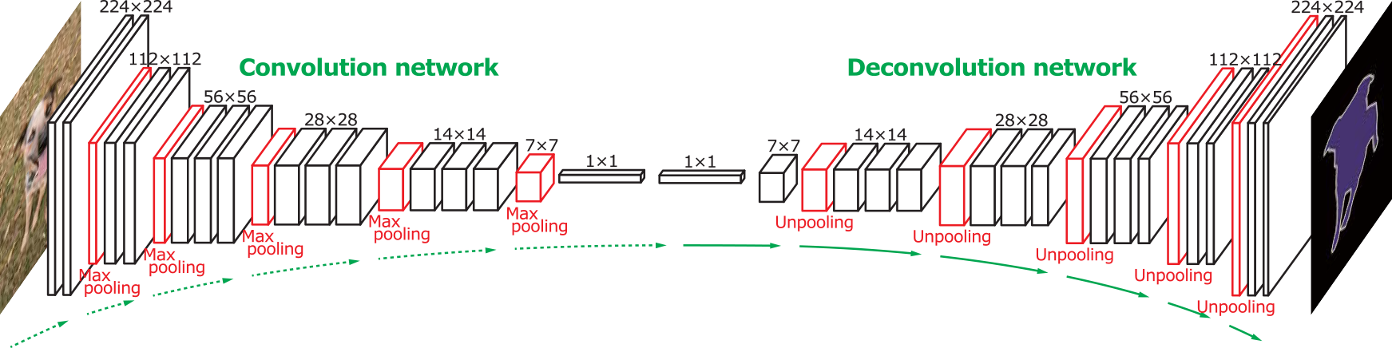
‘Deconvolution’ networks learn to upsample
Often called “deconvolution”, but misnomer.
Not the deconvolution that we saw in deblurring -> that is division in the Fourier domain.
‘Transposed convolution’ is better.
Zeiler et al., Deconvolutional Networks, CVPR 2010
Noh et al., Learning Deconvolution Network for Semantic Segmentation, ICCV 2015
Notes:
The network architecture here is VGG
Six days to train on an NVIDIA Titan X GPU

Slide 47

Upsampling with transposed convolution
Convolution
Notes:
https://www.quora.com/How-do-fully-convolutional-networks-upsample-their-coarse-output
https://github.com/vdumoulin/conv_arithmetic
https://en.wikipedia.org/wiki/Deconvolution
Also called ‘backwards strided convolution’.
Where the convolutions overlap, we ADD the output.
How do we apply the weights when the kernel crosses multiple input pixels from the previous layer?

Slide 48


Upsampling with transposed convolution
Transposed convolution = padding/striding smaller image then weighted sum of input x filter: ‘stamping’ kernel
Convolution
2x2, stride 1, 3x3 kernel,
upsample to 4x4
2x2, stride 2, 3x3 kernel,
upsample to 5x5.
Notes:
https://www.quora.com/How-do-fully-convolutional-networks-upsample-their-coarse-output
https://github.com/vdumoulin/conv_arithmetic
https://en.wikipedia.org/wiki/Deconvolution
Also called ‘backwards strided convolution’.
Where the convolutions overlap, we ADD the output.
How do we apply the weights when the kernel crosses multiple input pixels from the previous layer?

Slide 49
Kernel
1
1
1
1
1
1
1
1
1
Feature map
1 | 2
3 | 4
Padded feature map
 |  | 1 | 2
 |  | 3 | 4
Inspired by andriys
Notes:
Thanks to andriys
https://datascience.stackexchange.com/questions/6107/what-are-deconvolutional-layers
Note that the kernel here is not normalized, so if we were applying it as an image processing operation, then it would brighten the image significantly.
Note also that, in CNNs, there’s no need to normalize kernels – the operations on feature maps can learn to produce a large response if required.

Slide 50
Kernel
1
1
1
1
1
1
1
1
1
Output feature map
Input feature map
1 | 2
3 | 4
1 | 1 | 1
1 | 1 | 1
1 | 1 | 1
Padded input feature map
 |  | 1 | 2
 |  | 3 | 4
Inspired by andriys
Notes:
Thanks to andriys
https://datascience.stackexchange.com/questions/6107/what-are-deconvolutional-layers
Note that the kernel here is not normalized, so if we were applying it as an image processing operation, then it would brighten the image significantly.
Note also that, in CNNs, there’s no need to normalize kernels – the operations on feature maps can learn to produce a large response if required.

Slide 51
Kernel
1
1
1
1
1
1
1
1
1
Output feature map
Input feature map
1 | 2
3 | 4
1 | 4 | 4 | 3
1 | 4 | 4 | 3
1 | 4 | 4 | 3
Padded input feature map
 |  | 1 | 2
 |  | 3 | 4
Inspired by andriys
Notes:
Thanks to andriys
https://datascience.stackexchange.com/questions/6107/what-are-deconvolutional-layers
Note that the kernel here is not normalized, so if we were applying it as an image processing operation, then it would brighten the image significantly.
Note also that, in CNNs, there’s no need to normalize kernels – the operations on feature maps can learn to produce a large response if required.

Slide 52
Kernel
1
1
1
1
1
1
1
1
1
Output feature map
Input feature map
1 | 2
3 | 4
1 | 4 | 7 | 6 | 3
1 | 4 | 7 | 6 | 3
1 | 4 | 7 | 6 | 3
Padded input feature map
 |  | 1 | 2
 |  | 3 | 4
Inspired by andriys
Notes:
Thanks to andriys
https://datascience.stackexchange.com/questions/6107/what-are-deconvolutional-layers
Note that the kernel here is not normalized, so if we were applying it as an image processing operation, then it would brighten the image significantly.
Note also that, in CNNs, there’s no need to normalize kernels – the operations on feature maps can learn to produce a large response if required.

Slide 53
Kernel
1
1
1
1
1
1
1
1
1
Output feature map
Input feature map
1 | 2
3 | 4
1 | 4 | 7 | 8 | 5 | 2
1 | 4 | 7 | 8 | 5 | 2
1 | 4 | 7 | 8 | 5 | 2
Padded input feature map
 |  | 1 | 2
 |  | 3 | 4
Inspired by andriys
Notes:
Thanks to andriys
https://datascience.stackexchange.com/questions/6107/what-are-deconvolutional-layers
Note that the kernel here is not normalized, so if we were applying it as an image processing operation, then it would brighten the image significantly.
Note also that, in CNNs, there’s no need to normalize kernels – the operations on feature maps can learn to produce a large response if required.

Slide 54
Kernel
1
1
1
1
1
1
1
1
1
Output feature map
Input feature map
1 | 2
3 | 4
1 | 4 | 7 | 8 | 5 | 2
5 | 8 | 11 | 8 | 5 | 2
5 | 8 | 11 | 8 | 5 | 2
4 | 4 | 4
Padded input feature map
 |  | 1 | 2
 |  | 3 | 4
Inspired by andriys
Notes:
Thanks to andriys
https://datascience.stackexchange.com/questions/6107/what-are-deconvolutional-layers
Note that the kernel here is not normalized, so if we were applying it as an image processing operation, then it would brighten the image significantly.
Note also that, in CNNs, there’s no need to normalize kernels – the operations on feature maps can learn to produce a large response if required.

Slide 55
Kernel
1
1
1
1
1
1
1
1
1
Output feature map
Input feature map
1 | 2
3 | 4
1 | 4 | 7 | 8 | 5 | 2
5 | 18 | 21 | 18 | 5 | 2
5 | 18 | 21 | 18 | 5 | 2
4 | 14 | 14 | 10
Padded input feature map
 |  | 1 | 2
 |  | 3 | 4
Inspired by andriys
Notes:
Thanks to andriys
https://datascience.stackexchange.com/questions/6107/what-are-deconvolutional-layers
Note that the kernel here is not normalized, so if we were applying it as an image processing operation, then it would brighten the image significantly.
Note also that, in CNNs, there’s no need to normalize kernels – the operations on feature maps can learn to produce a large response if required.

Slide 56
Kernel
1
1
1
1
1
1
1
1
1
Output feature map
Input feature map
1 | 2
3 | 4
1 | 4 | 7 | 8 | 5 | 2
5 | 18 | 31 | 34 | 21 | 8
9 | 32 | 55 | 60 | 37 | 14
11 | 38 | 66 | 64 | 43 | 16
7 | 24 | 41 | 44 | 27 | 10
3 | 10 | 17 | 18 | 11 | 4
Padded input feature map
 |  | 1 | 2
 |  | 3 | 4
Inspired by andriys
Notes:
Thanks to andriys
https://datascience.stackexchange.com/questions/6107/what-are-deconvolutional-layers
Note that the kernel here is not normalized, so if we were applying it as an image processing operation, then it would brighten the image significantly.
Note also that, in CNNs, there’s no need to normalize kernels – the operations on feature maps can learn to produce a large response if required.

Slide 57
Kernel
1
1
1
1
1
1
1
1
1
Cropped output feature map
Input feature map
1 | 2
3 | 4
18 | 31 | 34 | 21
32 | 55 | 60 | 37
38 | 66 | 64 | 43
24 | 41 | 44 | 27
Padded input feature map
 |  | 1 | 2
 |  | 3 | 4
Inspired by andriys
Notes:
Thanks to andriys
https://datascience.stackexchange.com/questions/6107/what-are-deconvolutional-layers
Note that the kernel here is not normalized, so if we were applying it as an image processing operation, then it would brighten the image significantly.
Note also that, in CNNs, there’s no need to normalize kernels – the operations on feature maps can learn to produce a large response if required.

Slide 58
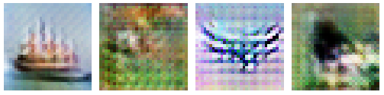
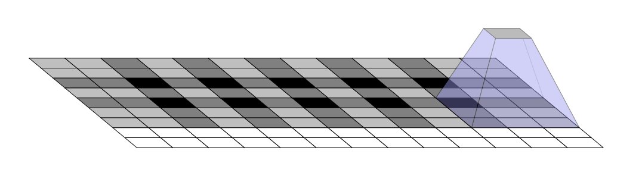
Is uneven overlap a problem?
Uneven overlap across output
Yes = causes grid artifacts
Could fix it by picking stride/kernel numbers which have no overlap…
Notes:
https://datascience.stackexchange.com/questions/6107/what-are-deconvolutional-layers
https://distill.pub/2016/deconv-checkerboard/

Slide 59
Is uneven overlap a problem?
Uneven overlap across output
Yes = causes grid artifacts
Could fix it by picking stride/kernel numbers which have no overlap…
Or…think in frequency!
Introduce explicit bilinear upsampling before transpose convolution; let kernels of transpose convolution learn to fill in only high-frequency detail.
https://distill.pub/2016/deconv-checkerboard/
Notes:
https://datascience.stackexchange.com/questions/6107/what-are-deconvolutional-layers
https://distill.pub/2016/deconv-checkerboard/

Slide 60
‘Deconvolution’ networks learn to upsample
Often called “deconvolution”, but misnomer.
Not the deconvolution that we saw in deblurring -> that is division in the Fourier domain.
‘Transposed convolution’ is better.
Zeiler et al., Deconvolutional Networks, CVPR 2010
Noh et al., Learning Deconvolution Network for Semantic Segmentation, ICCV 2015

Slide 61
But we have downsampled so far…
How do we ‘learn to create’ or ‘learn to restore’ new high frequency detail?

Slide 62
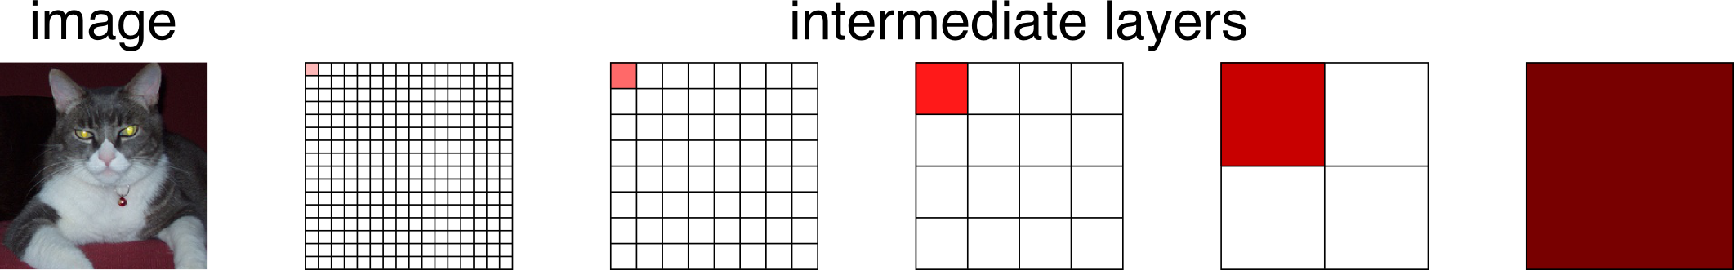
Spectrum of deep features
Combine where (local, shallow) with what (global, deep)
Fuse features into deep jet
(cf. Hariharan et al. CVPR15 “hypercolumn”)
[Long et al.]

Slide 63
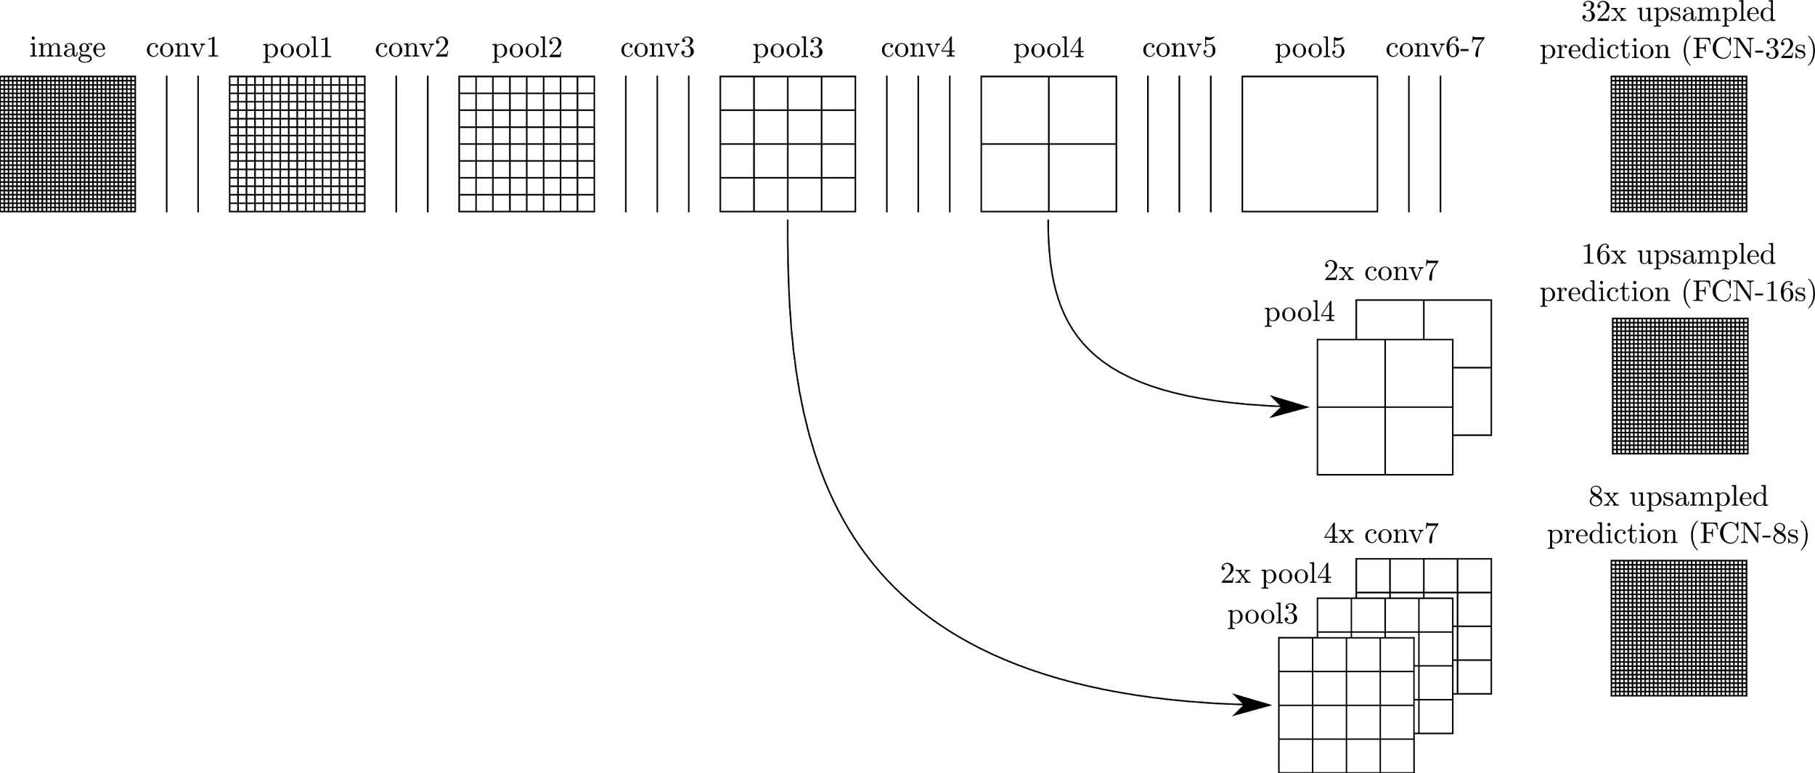
Learning upsampling kernels with skip layer refinement
interp + sum
Skip to fuse layers!
interp + sum
End-to-end, joint learning
of semantics and location
dense output
[Long et al.]

Slide 64
Learning upsampling kernels with skip layer refinement
interp + sum
Skip to fuse layers!
interp + sum
dense output
[Long et al.]

Slide 65
Learning upsampling kernels with skip layer refinement
interp + sum
Skip to fuse layers!
interp + sum
End-to-end, joint learning
of semantics and location
dense output
[Long et al.]

Slide 66
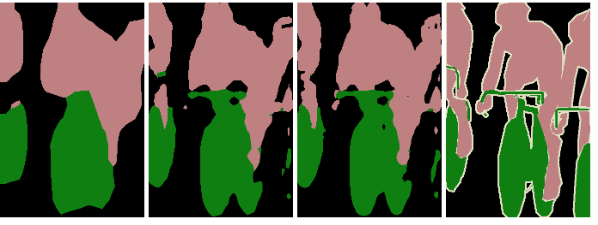
Skip layer refinement
input image
stride 32
stride 16
stride 8
ground truth
no skips
1 skip
2 skips
[Long et al.]

Slide 67
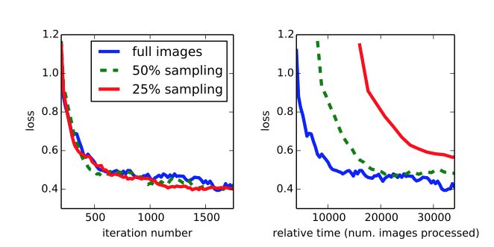
Training + testing
Train full image at a time without patch sampling
Reshape network to take input of any size
Forward time is ~100ms for 500 x 500 x 21 output
[Long et al.]

Slide 68
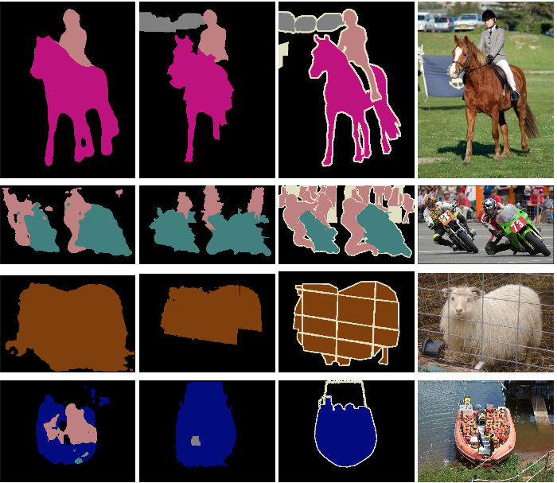
Results
FCN
SDS*
Truth
Input
Relative to prior state-of-the-art SDS:
30% relative improvement for mean IoU
286× faster
*Simultaneous Detection and Segmentation Hariharan et al. ECCV14
[Long et al.]
Notes:
+ NYUD net for multi-modal input and SIFT Flow net for multi-task output

Slide 69
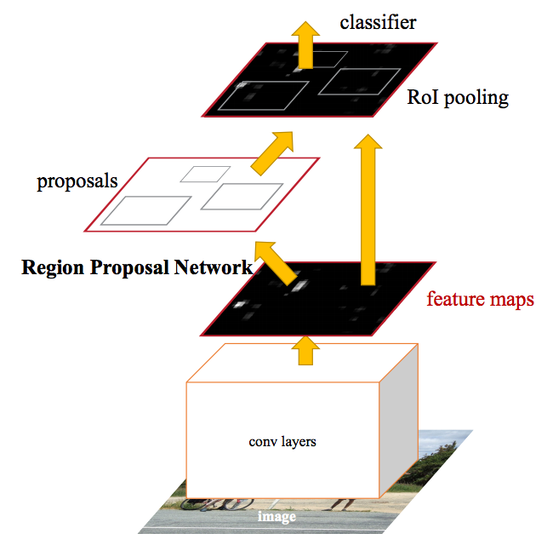
Even more: Faster R-CNN
(FCN)
‘Region Proposal Network’ uses CNN feature maps.
Then, FCN on top to classify. End to end object detection.
Ren et al. 2016 https://arxiv.org/abs/1506.01497
Notes:
https://blogs.microsoft.com/next/2015/12/10/microsoft-researchers-win-imagenet-computer-vision-challenge/#sm.00017fqnl1bz6fqf11amuo0d9ttdp

Slide 70
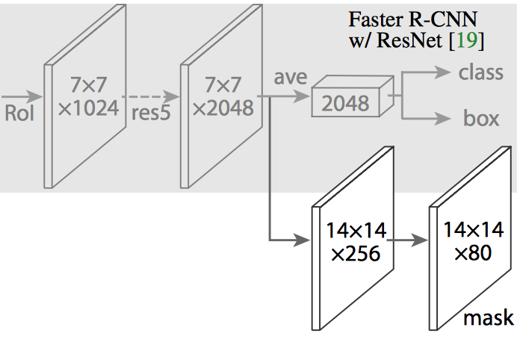
Even more! Mask R-CNN
Extending Faster R-CNN for Pixel Level Segmentation
He et al. - https://arxiv.org/abs/1703.06870
Add new training data: segmentation masks
Second output which is segmentation mask
Notes:
TensorFlow implementation: https://github.com/CharlesShang/FastMaskRCNN

Slide 71
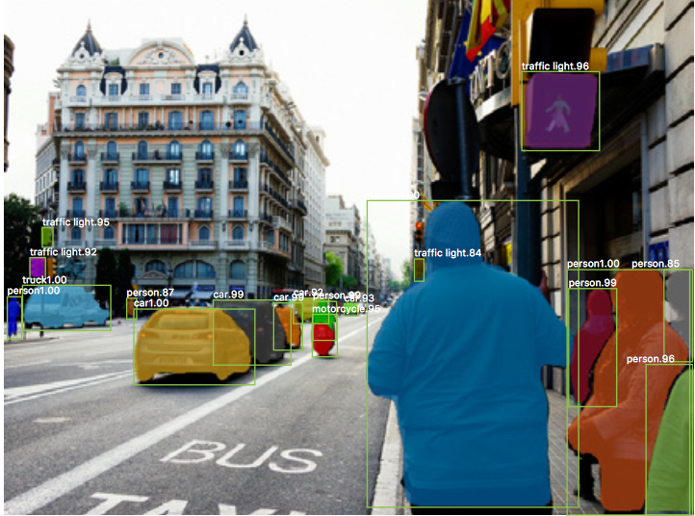

Slide 72
